Slide 1
UB TSO – Trade Finance Basics July 2016

Slide 2
Agenda
Trade Finance Basics
Trade Finance Lifecycle
Key Terminology
Trade Finance Products
Types of Trade Finance Documents

Slide 3
History of international trade -Important happenings:
According to Periplus Maris Erythraei, which is a Greek travel manuscript, written in the 1st century CE, there used to be extensive trade between Romans and the Indians.
The Song Dynasty created the first paper printed money and supported Brocade workshops . Aden, Siraf, Damietta and Alexandria were used as ports through, which the Abassids entered China and India.
Market rights as well as trading privileges were secured by Hanseatic League in England for goods in the year 1157.
Foreign trade licenses were introduced by Japan to prevent piracy and smuggling in the year 1592.
Dutch East India Company is established in the year 1602. The company declares bankruptcy in 1799 because of a rise in competition in free trade.
During the reign of Napoleon III, the Free Trade Agreement(year-1860) was struck between France and Britain.
In 1947, as many as 23 nations give their consent to the implementation of GATT (General Agreement On Tariffs And Trade).
NAFTA was formed on 1st January, 1994.
On 1st January, 1995, the World Trade Organization or the WTO came into being to promote free trade between various nations.
Notes:
ABN

Slide 4
Major Players in International Trade
Importers / Exporters
Actual players in International Trade
Banks
Facilitating Trade
ICC – International Chambers of Commerce
Standardization of Practices for terminologies/rules/laws used worldwide
Governments
Import Export Rules
Compliance Rules

Slide 5
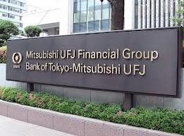
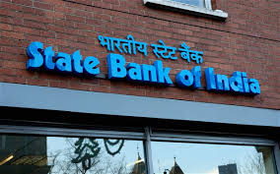
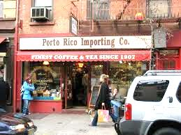
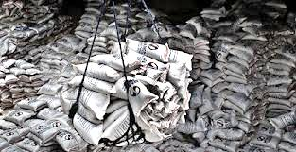
Trade Lifecycle - General
Buyers Bank / Financial Institution
(Issuing Bank in US)
6. Forwards Invoice & Trade Documents
Sellers Bank / Financial Institution
(Correspondent / Advising Bank in India)
9. Makes Payment
7. Buyer Receives Invoice & Trade Documents
5. Bank Purchases/Discounts & Makes Payment
4. Sends Invoice & Trade Documents
8. Makes Payment
Buyer/ Importer in US
3. Ships the Goods
Seller / Exporter in India
2. Confirms Purchase Order
1. Raises Purchase Order
5

Slide 6
Different methods of International Trade Settlement and risks :
1. Open account
2. Documentary Collections
2.1 Against payment i.e., DP
2.2 Documents against acceptance (DA)
3. Letter of credits
4. Advance payment

Slide 7
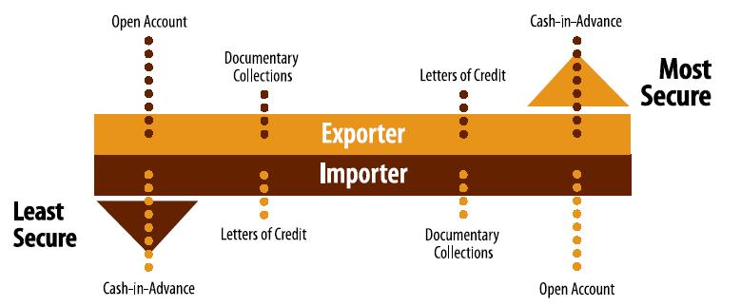
Different methods of International Trade Settlement and risks :

Slide 8
Open Accounts
Arrangement between the buyer and the seller
Manufactured goods will be delivered to the buyer directly or based on an order
Buyer will pay at the end of the agreed period
Seller should have a high degree of trust on the buyer

Slide 9
Open Account Lifecycle
Buyers Bank / Financial Institution
(Issuing Bank in US)
Sellers Bank / Financial Institution
(Correspondent / Advising Bank in India)
6. Makes Payment
7. Makes Payment
5. Makes Payment along with proof of transaction
Buyer/ Importer in US
4. Sends Invoice & Trade Documents
Seller / Exporter in India
3. Ships the Goods
2. Confirms Purchase Order
1. Raises Purchase Order
9

Slide 10
Documentary Collections
Documents (including a Bill of Exchange or draft) submitted through a bank for collection of payment from the drawee, also known as Bill for Collection.
Documents against Acceptance (DA)
Instruction used in Documentary Collections for commercial documents to be released to the drawee in exchange for the drawee’s acceptance of the Bill of Exchange.
2. Documents against Payment (DP)
Instruction used in BCs for documents to be released to the drawee in exchange for payment.

Slide 11
Documentary Collections Lifecycle
Buyers Bank / Financial Institution
(Collecting Bank in US)
6. Forwards Invoice & Trade Documents
Sellers Bank / Financial Institution
(Remitting Bank in India)
9. Makes Payment
8. Buyer Receives Invoice & Trade Documents
5. Bank Purchases/Discounts & Makes Payment
4. Sends Invoice & Trade Documents
7. Makes Payment or Agrees to Pay on a future date
Importer/ Drawee in US
3. Ships the Goods
Exporter / Drawer in India
2. Confirms Purchase Order
1. Raises Purchase Order
11

Slide 12
Letter of Credits
Arrangement where a bank acting at the request and on the instructions of a customer or its own behalf:
I. Undertakes to make a payment to or to the order of a third party (i.e. the seller) or undertakes to accept and pay Bill of Exchange drawn by the beneficiary,
Or
II. Authorizes another bank to effect such a payment or accept and pay such bills of exchange
Against the stipulated documents provided that the terms and conditions of the credit are complied with‘‘.

Slide 13
Letter of Credit Lifecycle
(Issuing Bank in US)
8. Forwards Invoice & Trade Documents
(Advising Bank in India)
4. Issues LC
11. Makes Payment
3. Applies for LC Issuance
10. Buyer Receives Invoice & Trade Documents
12. Makes Payment
5. Advises the LC
7. Sends Invoice & Trade Documents
(Discounting)
9. Makes Payment
Applicant in US (Importer)
6. Ships the Goods
Beneficiary in India (Exporter)
2. Confirms Purchase Order
1. Raises Purchase Order
13

Slide 14
Advance Payments
The entire risk of the trade is on the buyer :
Non-delivery of goods
Delayed delivery of goods
Defective quality and short supply
Capital being blocked in the form of advance payment.
The seller does not intend to take risks on the buyer.
The political or economic environment in the buyer‘s country may be unstable.
The amount involved may be small and hence, the seller does not want to be bothered with formalities associated with other forms of payment.
The seller may be in a position to dictate terms with the buyer and hence, wants to leverage the situation favorably.

Slide 15
Advance Payment Lifecycle
Buyers Bank / Financial Institution
(Issuing Bank in US)
8. Forwards Invoice & Trade Documents
Sellers Bank / Financial Institution
(Correspondent / Advising Bank in India)
4. Makes Payment
9. Buyer Receives Invoice & Trade Documents
5. Makes Payment
7. Sends Invoice & Trade Documents
3. Makes Payment
Buyer/ Importer in US
6. Ships the Goods
Seller / Exporter in India
2. Confirms Purchase Order
1. Raises Purchase Order
15

Slide 16
Major Documents used in International Trade
Purchase Orders
Commercial Invoices
Packing/weight list
Certificate of Origin
Inspection/Analysis Certificates
Transport Documents
Drafts/Bill of Exchange
Insurance Documents
Others

Slide 17
Commercial Invoice
Itemized account issued by the beneficiary and
addressed to the applicant,
must be supplied in the number of copies specified in the letter of credit.
It need not be signed.

Slide 18
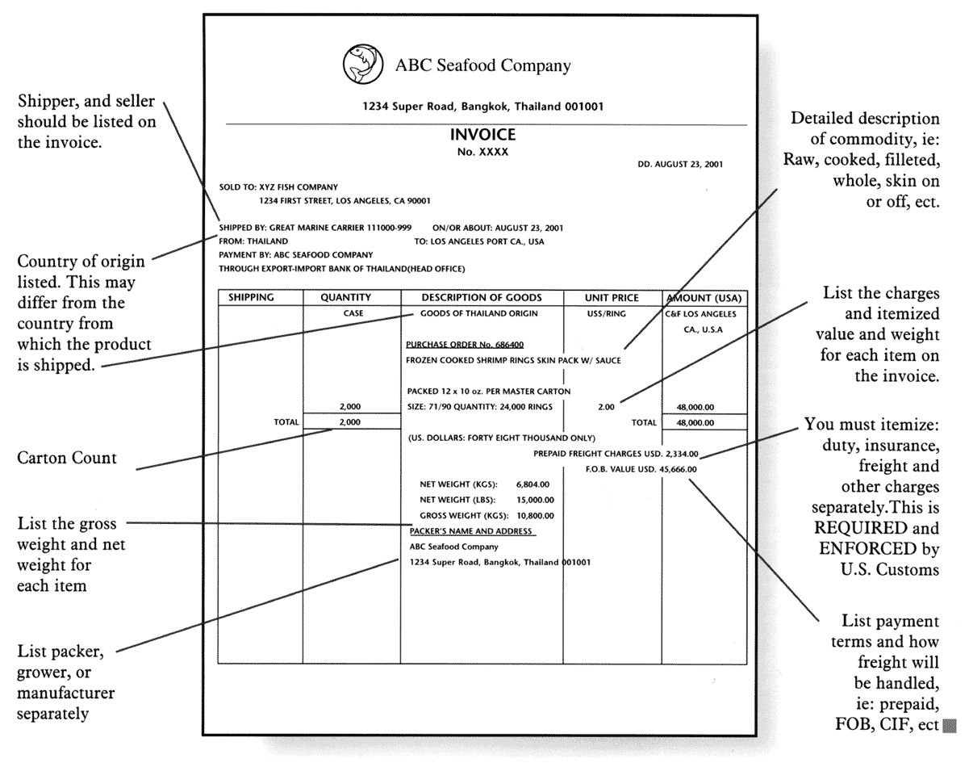
Commercial Invoice
Sample

Slide 19
Packing List
A packing list is usually requested by the buyer
To assist in identifying the contents of each package or container.
It must show the shipping marks and number of each package.
It is not usually required to be signed.

Slide 20
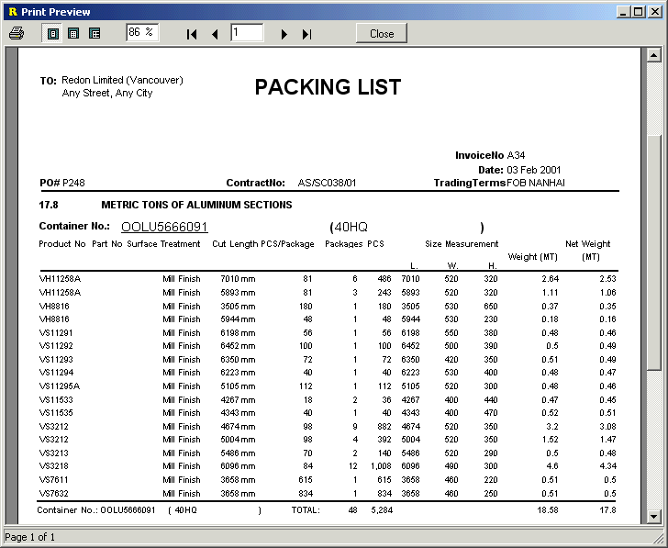
Packing List
Sample

Slide 21
Certificate of Origin
Certifies as to the country of origin of the goods described.
Should comply with any stipulations in the letter of credit as to originating country.
Should comply with any stipulations in the letter of credit as to by whom the certificate is to be issued.
The certificate should be consistent with and identified with the other shipping documents by shipping marks and numbers.
The certificate must be signed.

Slide 22
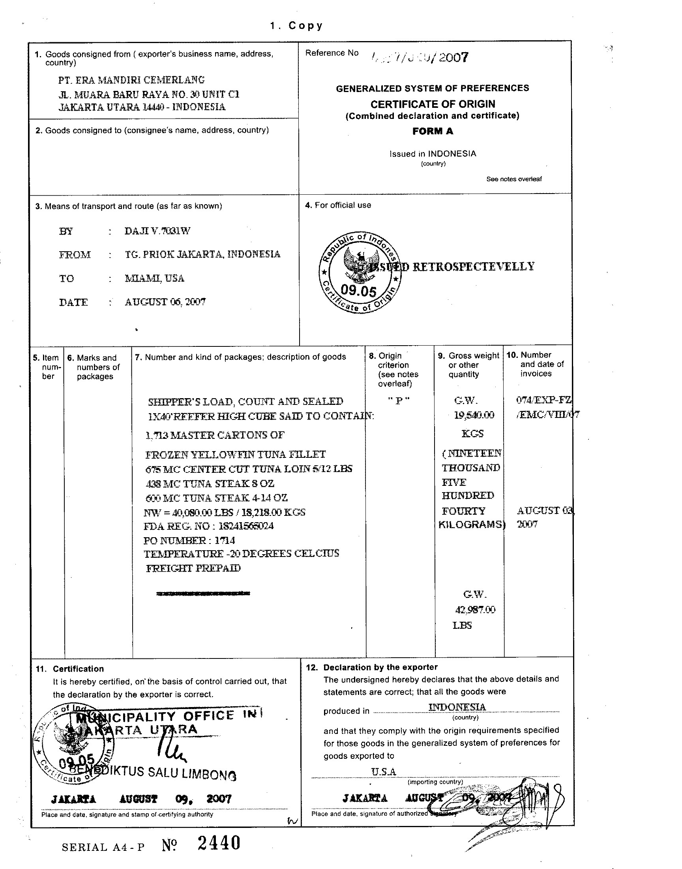
Certificate of Origin
Sample

Slide 23
Inspection/Analysis Certificates
As a preventative measure against fraud.
Means of protecting the buyer against the possibility of receiving substandard or unwanted goods.
certificates indicate that the goods have been examined and found to be as
ordered.

Slide 24
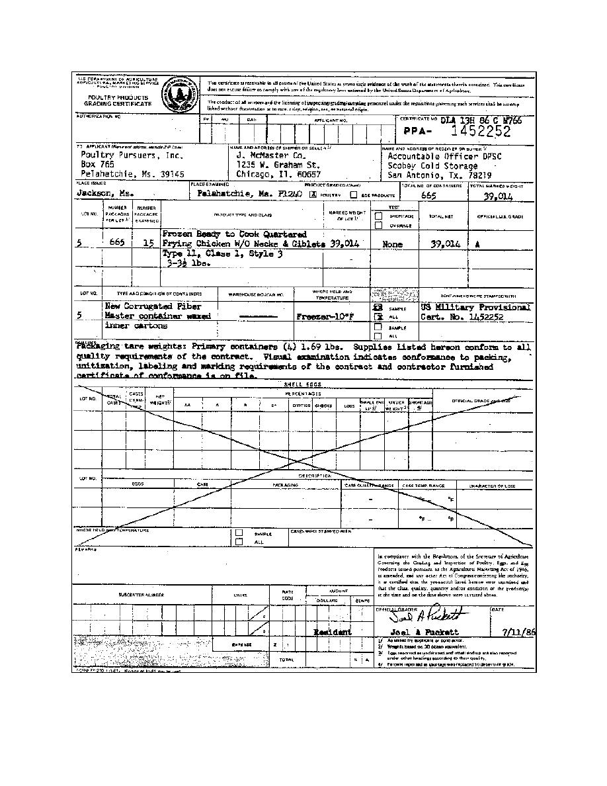
Inspection Certificates
Sample

Slide 25
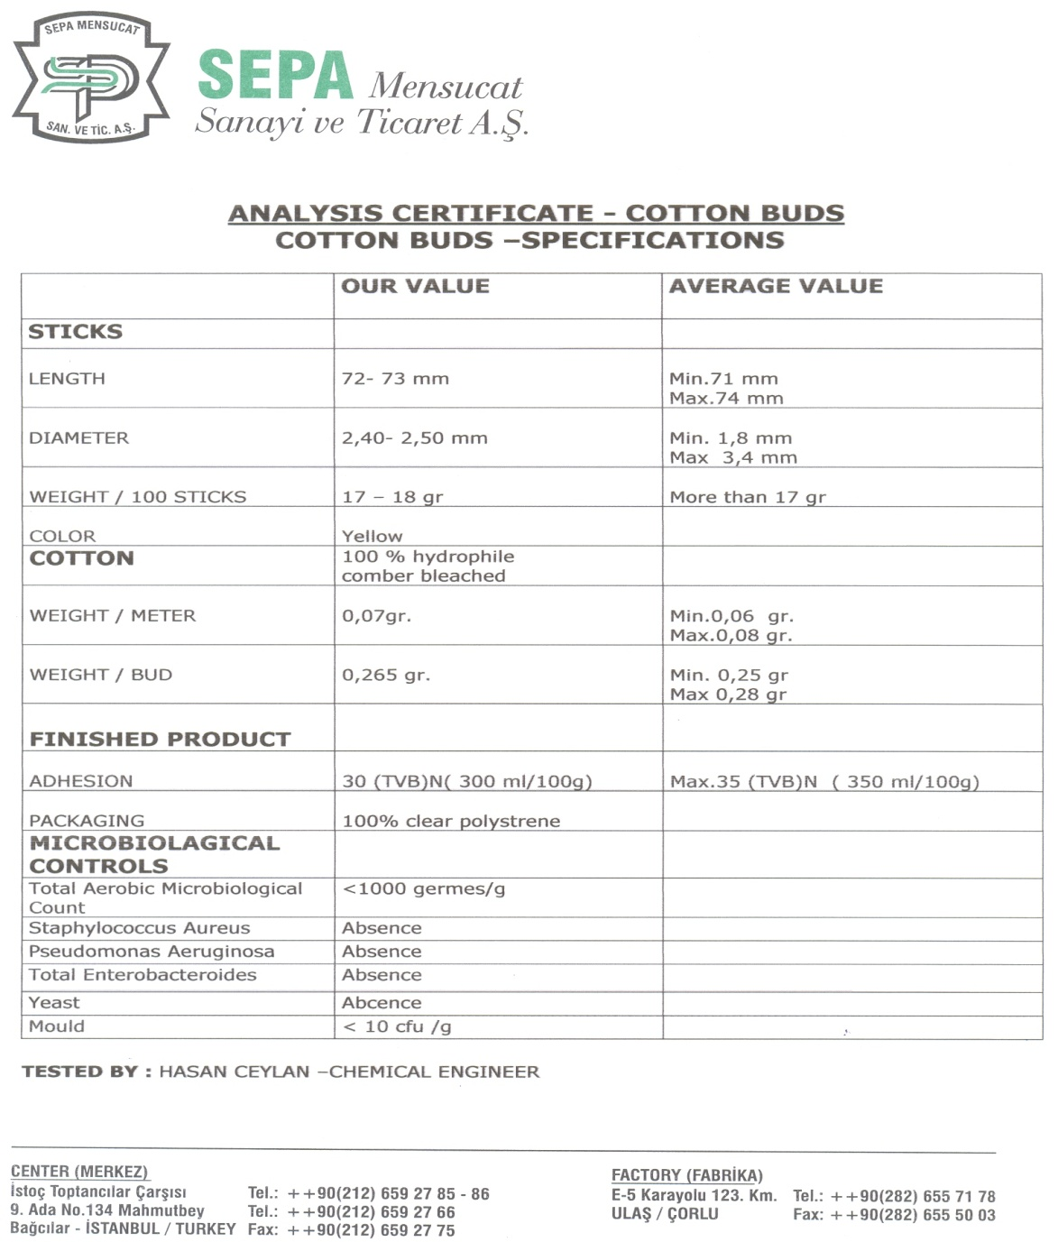
Analysis Certificates
Sample

Slide 26
Transport Documents
Classified according to mode of transportation:
Ocean – Marine/Ocean Bill of Lading (B/L), Seaway B/L, House Bill of Lading, Charter Party B/L
Air – Airway Bill, House Airway Bill
Road Transport – Truck B/L, CMR
Others – Rail Receipt, Courier Receipt, Multimodal B/L, Forwarders Cargo Receipt (FCR).

Slide 27
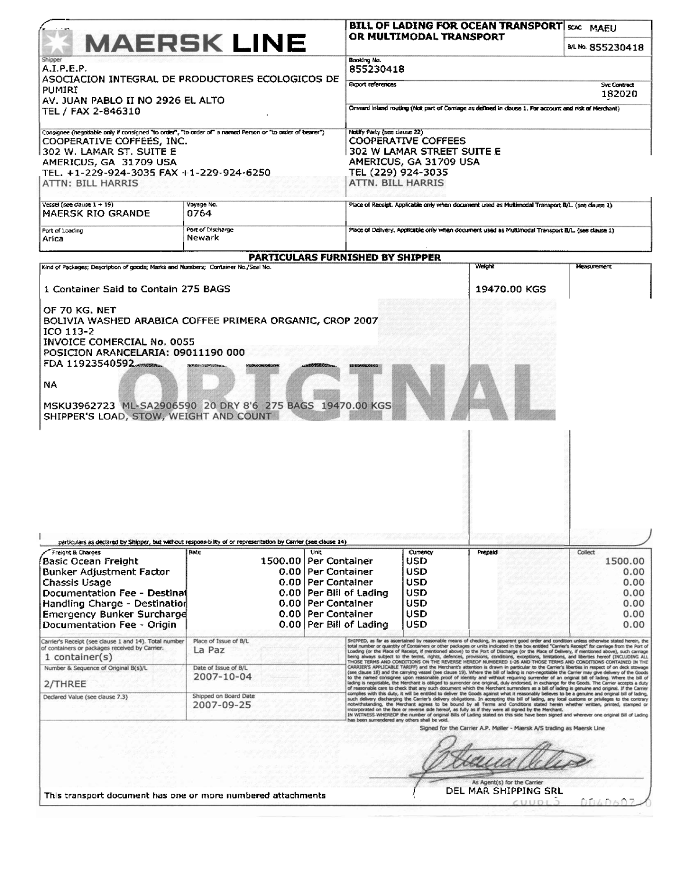
Transport Documents – Bill of lading
Sample
Sample

Slide 28
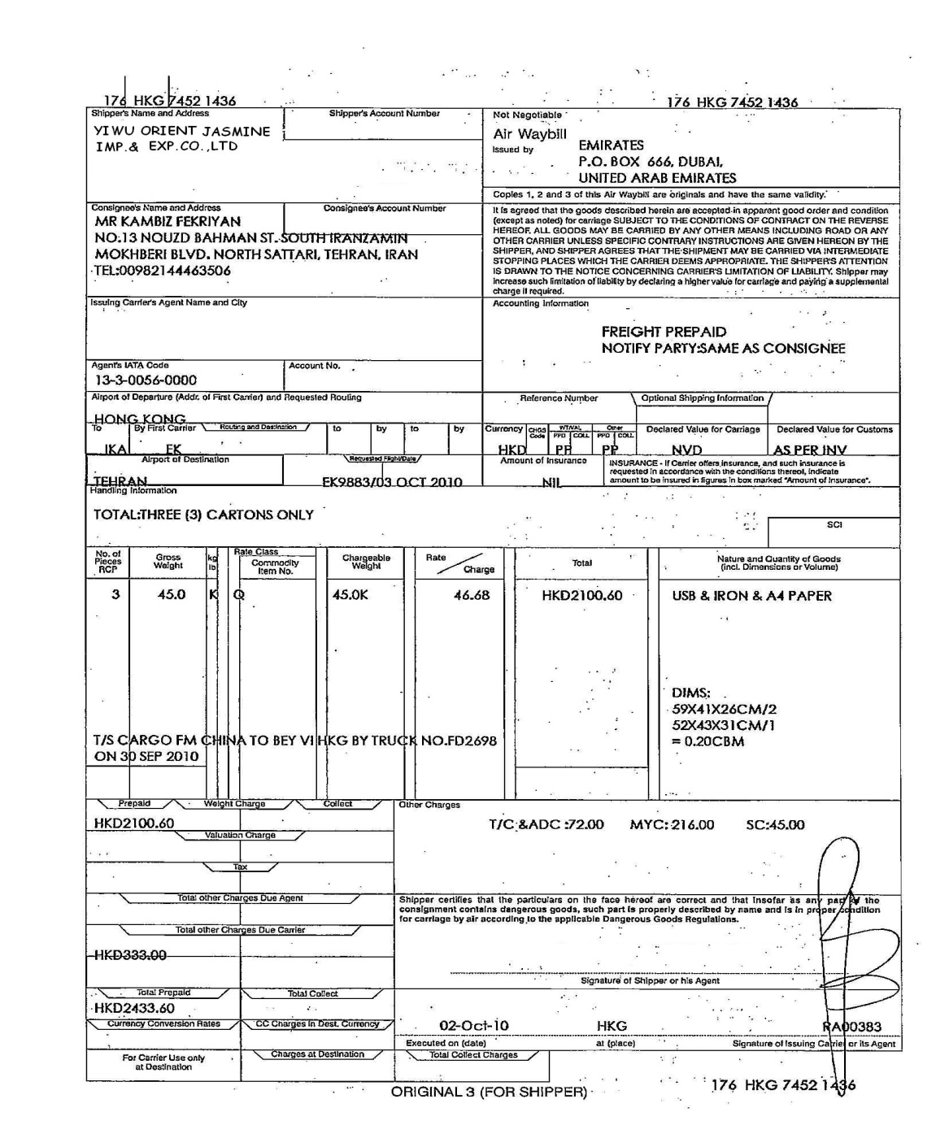
Transport Documents – Airway bill
Sample

Slide 29
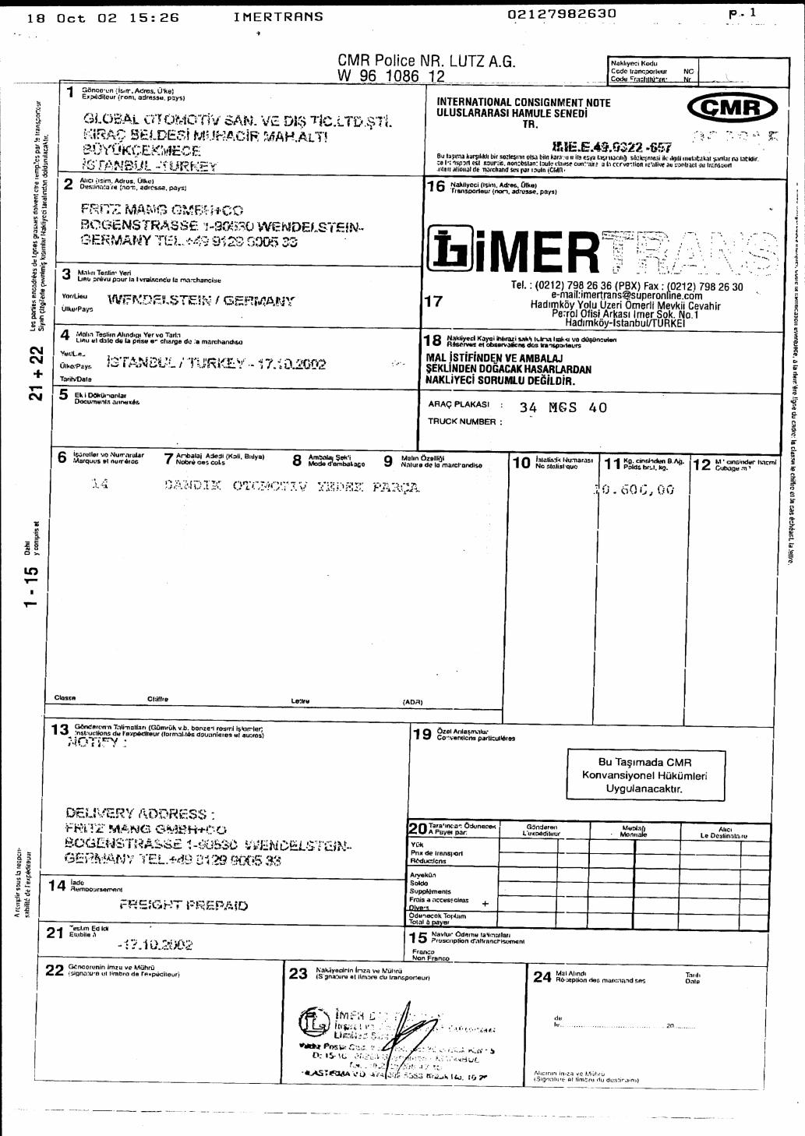
Transport Documents – Truck Consignment Note
Sample

Slide 30
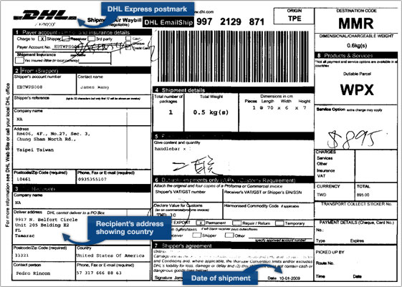
Courier Receipt
Sample

Slide 31
Drafts/Bill of Exchange
Legally enforceable instrument
Formal evidence of debt under a letter of credit.
Drafts drawn at sight are payable by the drawee on presentation.
Term (usance) drafts, after acceptance by the drawee, are payable on their indicated due date.
Drafts must be drawn and signed by the beneficiary of the letter of credit.
The terms of the draft must be expressed in accordance with the tenor shown in the letter of credit;
e.g., at sight or at a stated number of days after B/L or Shipment Date
Draft should never be drawn on the applicant in case of LC.

Slide 32
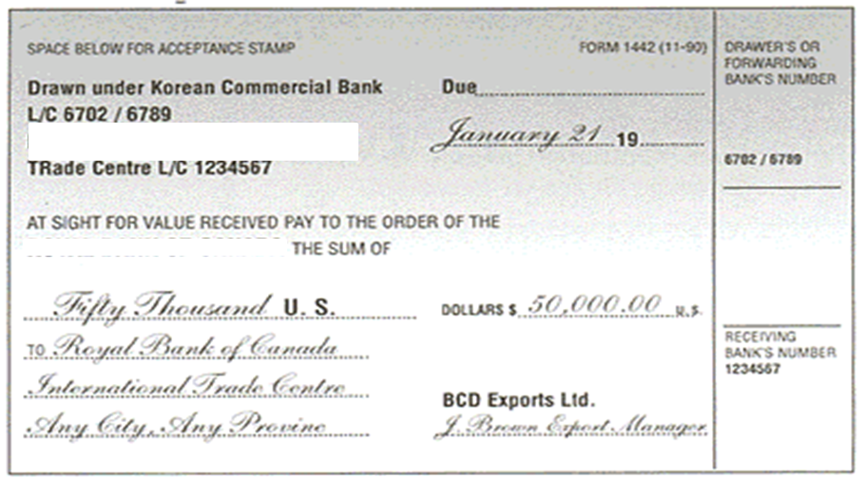
Drafts/Bill of Exchange
Sample

Slide 33
Insurance Documents
Undertaking given by the insurers promising to pay money as compensation in case the goods are subjected to loss/theft/damage.
Insurance Policy
Specific Policy
Open Policy
Insurance certificate
Insurance Cover Note

Slide 34
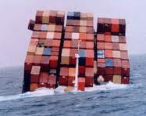
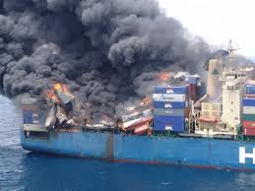
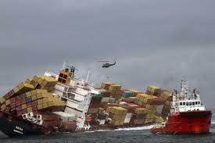
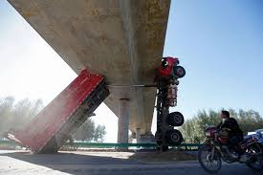
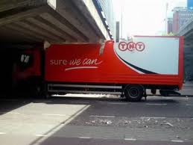
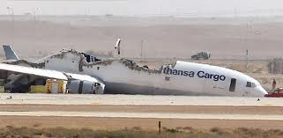
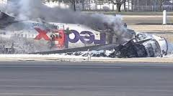
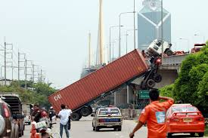
Insurance Documents

Slide 35
Other Documents
Phytosanitary Certificate
Beneficiary Certificate
Fisheries Certificate

Slide 36
End of Session1
Questions….
Thank you!

